Slide 1

Bible Interpretation
The Reliability and Usability of Scripture In Our Present Age

Slide 2
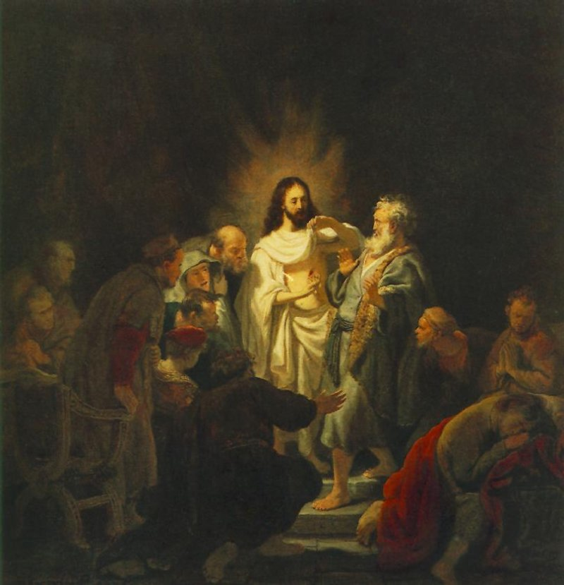
A Growing Crisis
In Biblical Authority
Harmensz Rijn Rembrandt
1606 – 1669. Doubting Thomas

Slide 3
The Cultural Challenge in Bible Interpretation:
You must understand this, that in the last days distressing times will come. 2Tim. 3:1
  Individualism
  Populism
  Anti-Intellectualism
What feels right may not be right

Slide 4
Individualism:
"It's all a matter of one’s own own, private, Interpretation”’
  The revivalist of the Second Great Awakening... argued (as the secularists had a century earlier) that his revelation was not properly mediated by either tradition or theology; it came directly to each individual through personal experience. As a result, the individual became the arbiter of what the Bible did and did not say.
  The new evangelical coalition attached little importance to the aid of the past or even the present community of interpreters in matters of biblical interpretation. External authorities were jettisoned and divine authority was internalized-- a strategy not altogether different from that of the Enlightenment.
  Rick Lints, Fabric of Theology

Slide 5
Individualism:
"It's all a matter of one’s own own, private, Interpretation”’
Compare:
  1Tim. 3:15 if I am delayed, you may know how one ought to behave in the household of God, which is the church of the living God, the pillar and bulwark of the truth.
  Eph.4:11 And he gave some, apostles; and some, prophets; and some, evangelists; and some, pastors and teachers; 12 For the perfecting of the saints, for the work of the ministry, for the edifying of the body of Christ: 13 Till we all come in the unity of the faith, and of the knowledge of the Son of God, unto a perfect man, unto the measure of the stature of the fullness of Christ.

Slide 6
Populism
"The common sense of the majority is right”
(Democratization)
In America the principal mediator of God's voice has not been state, church, council, confession, ethnic group, university college or seminary; it has been quite simply, the people... the impulse to rework Christianity into forms that were unmistakably popular... and democratic in at least three respects: it was audience centered, intellectually open to all, and organizationally pluralistic and innovative.
    Nathan Hatch,
    "Evangelicalism as a Democratic Movement"

Slide 7
Populism
"The common sense of the majority is right”
(Democratization)
Compare:
Matt. 7:13 “Enter through the narrow gate; for the gate is wide and the road is easy that leads to destruction, and there are many who take it. 14 For the gate is narrow and the road is hard that leads to life, and there are few who find it.
Matt. 22:14 For many are called, but few are chosen.
Rom. 9:27 And Isaiah cries out concerning Israel: “Though the number of the sons of Israel be as the sand of the sea, only a remnant of them will be saved,
Heb. 11:13 These all died in faith, not having received the things promised, but having seen them and greeted them from afar, and having acknowledged that they were strangers and exiles on the earth.

Slide 8
Anti-Intellectualism:
"Less is more"
By thus admitting the sovereignty of the audience,,, the new ground rules for theology, opening it to all, meant that the measure of theology would be its acceptability in the marketplace of ideas. This meant that uncomfortable complexity would be flattened out, that issues would be resolved by a simple choice of alternatives, and that in many cases the fine distinctions from which truth alone can emerge were lost in the din of ideological battle.
[About Alex de Tocqueville]
Expecting that great freedom of thought would generate great ideas, he found instead that Americans easily became "slaves of slogans. Expecting to find priests, he found politicians."
Nathan Hatch, The Democratization of American Christianity

Slide 9
Anti-Intellectualism:
"Less is more"
Compare:
  Rom. 12:2 Do not be conformed to this world, but be transformed by the renewing of your minds, so that you may discern what is the will of God--what is good and acceptable and perfect.
  2Cor. 10:5 Casting down imaginations, and every high thing that exalteth itself against the knowledge of God, and bringing into captivity every thought to the obedience of Christ;
  1Tim. 1:7 desiring to be teachers of the law without understanding either what they are saying or the things about which they make confident assertions… 4:1 Now the Spirit expressly says that in later times some will depart from the faith by devoting themselves to deceitful spirits and teachings.

Slide 10
The Sum Effect of it all?
The bible becomes captive to the whims of the individual freed from external constraints, and in such a situation the individual can imagine the text to say whatever he or she wants it to say. If our central concern in approaching the text is how it makes us feel or what it seems to be saying to us, then the church is doomed to having as many interpretations of the text as the interpreters. Having rejected the aid of the community of interpreters throughout the history of Christendom, we have not succeeded in returning to the primitive gospel; we have simply managed to plunge ourselves back to the biases of our own individual situations.
Rick Lints, Fabric of Theology

Slide 11
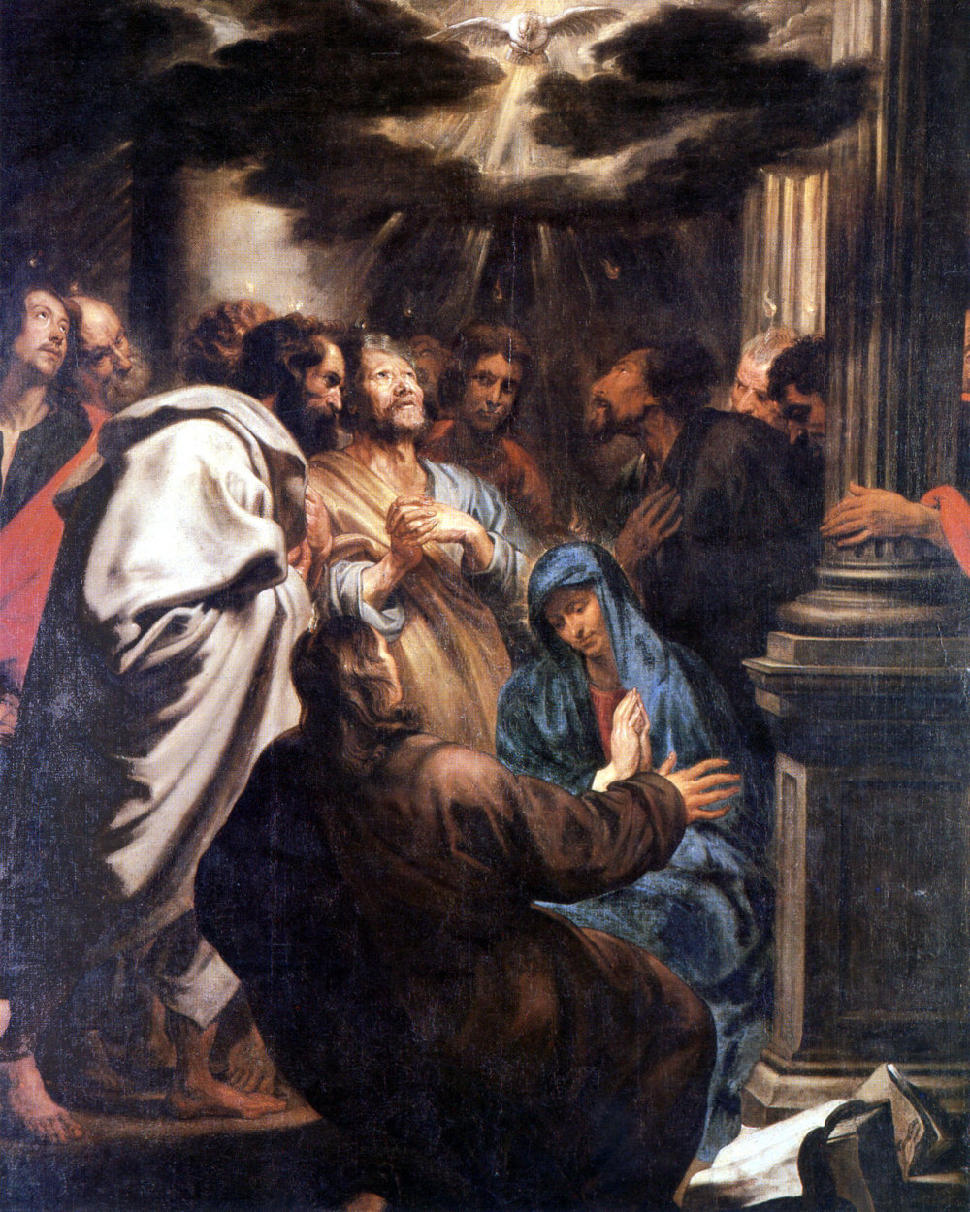
Two Common Confusions In Bible Interpretation:
The Role of the Holy Spirit
The Role of the Church
Anthony Van Dyck
1599 – 1641
The Descent of the Holy Spirit

Slide 12
Revelation vs. Illumination
Westminster Confession of Faith, Section 6
The whole counsel of God concerning all things necessary for his own glory, man's salvation, faith and life, is either expressly set down in Scripture, or by good and necessary consequence may be deduced from Scripture: unto which nothing at any time is to be added, whether by new revelations of the Spirit, or traditions of men.
Nevertheless, we acknowledge the inward illumination of the Spirit of God to be necessary for the saving understanding of such things as are revealed in the Word: and that there are some circumstances concerning the worship of God, and government of the church, common to human actions and societies, which are to be ordered by the light of nature, and Christian prudence, according to the general rules of the Word, which are always to be observed.

Slide 13
The Role of Holy Spirit In Interpreting Scripture
A. Does: “Nevertheless, we acknowledge the inward illumination of the Spirit of God to be necessary for the saving understanding of such things as are revealed in the Word”
    Rom. 8:6-8 For the mind set on the flesh is death, but the mind set on the Spirit is life and peace, 7 because the mind set on the flesh is hostile toward God; for it does not subject itself to the law of God, for it is not even able {to do so}; 8 and those who are in the flesh cannot please God.
    1 Cor. 2:12-14--Now we have received, not the spirit of the world, but the Spirit who is from God, that we might know the things freely given to us by God, 13 which things we also speak, not in words taught by human wisdom, but in those taught by the Spirit, combining spiritual {thoughts} with spiritual {words.} 14 But a natural man does not accept the things of the Spirit of God; for they are foolishness to him, and he cannot understand them, because they are spiritually appraised.

Slide 14
The Role of Holy Spirit In Interpreting Scripture
B. Doesn’t Do: ... those former ways of God’s revealing his will unto his people being now ceased...(1.1b), ... unto which nothing at any times is to be added, whether by new revelations of the Spirit, or traditions of men...” (1.6)
    Heb. 1:1-3—God “spoke”... not “speaks”
    Eph. 2: 20 built upon the foundation of the apostles and prophets, with Christ Jesus himself as the cornerstone.
    Rev.22:18 ...if anyone adds to them.

Slide 15
Revelation vs. Illumination
  Holy Spirit and Revelation: The Holy Spirit plays an objective role, not subjective, in biblical inspiration. As contained in the scriptures of the Old and New Testament, revelation (meaning) is now ceased until the return of Christ.
  Holy Spirit in Illumination: active in us subjectively such as to give us “eyes to see and ears to hear, it is a vital aspect of our ability to discern what God is telling us through scripture and its significance in our lives.
.

Slide 16
Summary Role of the Holy Spirit:
"The Holy Spirit plays a subjective, not objective, role in biblical interpretation. In reconciling our sinful hearts to God, he promotes within us a similar desire to love and serve God as we have to love and serve our natural parents. Further, he particularly gives us the desire to embrace and receive the things of God. In doing this, he makes us willing to work hard to understand scripture, and willing to embrace the conclusions of our study of scripture.
Our view is distinct from the view of Rome, which argued that the difficulty of understanding scripture aright was due to scripture's obscurity and perplexity; Protestants responded by saying the difficulty was due to our obscurity and perplexity. On the other side of the Reformers, battling from another direction, were the anabaptists, who joined Rome in claiming scripture to be intellectually unclear and in need of further revelation and information. Thus, the Holy Spirit is most necessary in removing that sin and love of sin which is that which effectively prevents us from embracing and receiving the things of God."
T. David Gordon

Slide 17
The Role of Holy Spirit
In Interpreting Scripture
It is a false dichotomy to pit the “Holy Spirit” filled life and the Scripture filled life—why?
    2Pet. 1:19 For no prophecy was ever produced by the will of man, but men spoke from God as they were carried along by the Holy Spirit.
Apostolic Foundation Is Contained to Scripture:
    Acts 2:42 And they devoted themselves to the apostles’ teaching
    Eph 2:20 built on the foundation of the apostles and prophets, Christ Jesus himself being the cornerstone
      Note : John 15:26-27 --When the Advocate comes, whom I will send to you from the Father, the Spirit of truth who comes from the Father, he will testify on my behalf.
Warning
    Rev. 22:18 I warn everyone who hears the words of the prophecy of this book: if anyone adds to them, God will add to him the plagues described in this book, 19 and if anyone takes away from the words of the book of this prophecy, God will take away his share in the tree of life and in the holy city, which are described in this book.

Slide 18
A Misunderstood Passage: (c.f. John 15 26-27
John 14:25-26
“I have said these things to you while I am still with you. 26 But the Advocate, the Holy Spirit, whom the Father will send in my name, will teach you everything, and remind you of all that I have said to you”.
  1. To whom is this addressed? The disciples in the Upper Room. The twice-repeated “you” of v. 26 has the same referent as the “you” at the end of 25 and the end of 26.
  2. What is promised to the disciples? The Holy Spirit.
  3. What will the Holy Spirit do? He will teach-remind (note the parallel between teaching and reminding here). His “teaching,” even among the disciples, is not new information, but a remembrance of the many things which Jesus had already said.
  4. What will be the content of the Spirit's teaching-reminding among the disciples? What is the referent of the ”everything” ? This is answered by the relative clause, “that I have said to you”. This clause is almost certainly further defined by the first clause of 25, “I have said these things to you while I am still with you” .
  5. Conclusions from John 14.25,26. This text records a special promise of the Holy Spirit to the disciples guaranteeing that they will be helped to remember what Jesus taught them while he was with them such a to put into writing the “foundations built upon Christ as cornerstone” (Eph 2:20). A number of other texts affirm that this is precisely what happened. (c.f. 2 Peter 1:20– “eyewitness.., not a matter of own interpretation)

Slide 19
Summary Role of the Holy Spirit continued:
The Holy Spirit does not give us special insight into the correct interpretation/meaning of a given biblical passage...
[Assuming the sufficiency of scripture] the role of the Holy Spirit is to make us a receptive recipient of the origional meaning of the Word of God such as to discern it’s relevance to a faithful life with God. T.

Slide 20
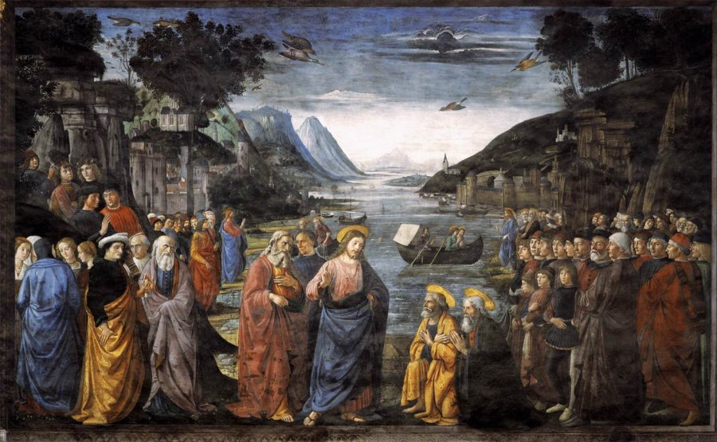
The Role of the Church In Interpretation
Domenico Ghirlandaio 1449 – 1494
The Calling of Peter and Andrew

Slide 21
What The Church Does and Doesn’t Do In Interpretation
“nor traditions of men”
It Does NOT add to the revelation in scripture: "unto which nothing at any time is to be added,
  Protestant revolution was not about inspiration or tradition, but over a matter of authority. Whether the church in its teaching office had the right to impose meanings on the Biblical text which was not itself subject to correction by that text. Protestants held that Scripture was no longer free-- church teaching was silencing Biblical teaching.

Slide 22
A Comparison of Westminster and Trent (1545-63) on ecclesiastical tradition:
Trent:
“The sacred and holy, ecumenical, and general Synod of Trent--…following the examples of the orthodox Fathers, receives and venerates with an equal reverence, all the books both of the Old and of the New Testament--seeing that one God is the author of both--as also the said traditions, as well those appertaining to faith as to morals, as having been dictated, either by Christ’s own word of mouth, or by the Holy Ghost, and preserved in the Catholic Church by a continuous succession.…
Westminster 20.2
God alone is Lord of the conscience, and hath left it free from the doctrines and commandments of men, which are, in anything, contrary to his Word; or beside it, if matters of faith, or worship. So that, to believe such doctrines, or to obey such commands, out of conscience, is to betray true liberty of conscience: and the requiring of an implicit faith, and an absolute and blind obedience, is to destroy liberty of conscience, and reason also..

Slide 26
“Moved and induced by testimony of the church”
What the Church DOES:
  WCF 1.5. We may be moved and induced by the testimony of the church:
      to an high and reverent esteem of the Holy Scripture.
      And the heavenliness of the matter,
      the efficacy of the doctrine,
      the majesty of the style,
      the consent of all the parts,
      the scope of the whole (which is, to give all glory to God)…
      whereby it doth abundantly evidence itself to be the Word of God: yet notwithstanding, our full persuasion and assurance of the infallible truth and divine authority thereof, is from the inward work of the Holy Spirit bearing witness by and with the Word in our hearts.

Slide 27
“Moved and induced by testimony of the church”
What the Church DOES (continued):
  To the degree that the ”one holy catholic church” (the church of all times and places) is best able to transcend the socio-cultural-philosophical and sectarian biases, and to the degree that the church together is able to more thoroughly study the scriptures over time, we can therefore be more confident in our interpretation of scripture to the degree that it is a “consensus” interpretation, especially regarding those things "not alike plain in themselves nor alike clear unto all” (section7). The church then becomes a function of illumination vs. Revelation!
  The church (collectively) not the individual is said to be the ”pillar and bulwark of the truth, even as Paul exhorts Timothy to respect the “traditions” (e.g. confessional consensus” passed down).
      1 Timothy 3:15, you may know how one ought to behave in the household of god, which is the church of the living God, the pillar and bulwark of the truth.
      2Th. 2:15 So then, brothers, stand firm and hold to the traditions that you were taught by us, either by our spoken word or by our letter.

Slide 28
The Role of the Multi-Generational/Cultural Church
In Interpreting Scripture
There are Generally 3 Options In How To Interpret the Bible:
Read it Individually: Susceptible to MY own socio-cultural and sinful bias. (Individual)
1 Tim. 4:16 Keep a close watch on yourself and on the teaching. Persist in this, for by so doing you will save both yourself and your hearers.
Read it within the historically bound “bubble” of my particular and local community as to be susceptible to OUR social-cultural and sinful biases. (Sectarian) .
Gal. 3:28 There is neither Jew nor Greek, there is neither slave nor free, there is no male and female, for you are all one in Christ Jesus.
Read it Confessionally (using confessions of faith passed down) with the community of faith of every age and place toward a consensus that transcends the bias of a particular time and/or culture.
1Tim. 3:15 if I delay, you may know how one ought to behave in the household of God, which is the church of the living God, a pillar and buttress of the truth.

Slide 29
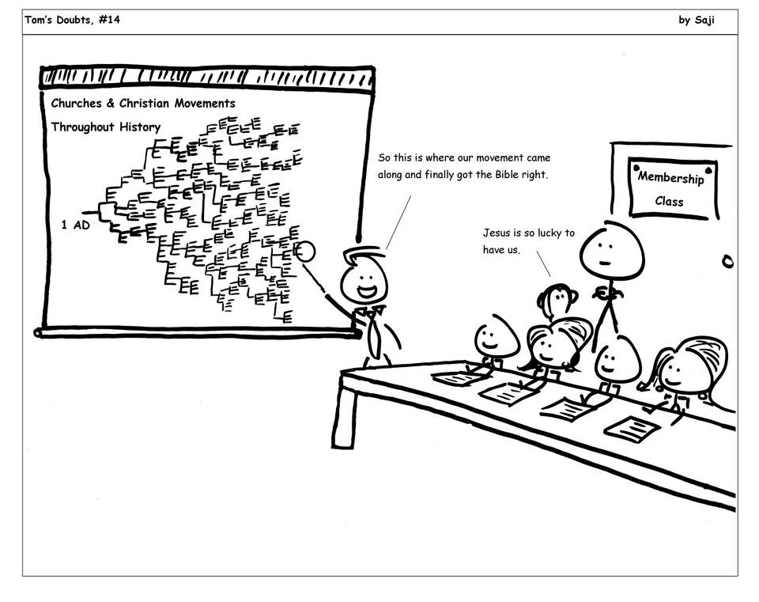
An Amazing Ignorance, if not Arrogance, in Bible Interpretation Illustrated

Slide 30
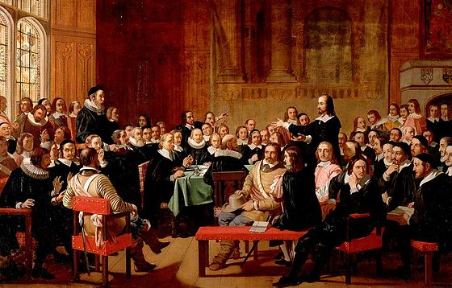
The Use of Creeds In
Interpretation
The Westminster Assembly, 1643
by John Rogers Herbert, 1969

Slide 31
Ecumenical Creeds
Nicene Creed (325, amended in Constantinople in 381)
Apostles Creed (Before 370, the earliest reference)
Athanasus Creed (5th century)
These creeds are accepted by almost all mainstream Christian Denominations in the West, including Lutheran, Reformed, Roman Catholic, andAnglican
Many Methodist churches accept the Nicene Creed and Apostles' Creed
The Eastern Orthodox accepts the Nicene Creed,^{[8][9]} but does not use the Apostles' Creed or the Athanasian Creed.

Slide 32
Reformed Confessions
The Scots Confession (1560)—approved by Reformation Parliament and Church of Scotland, attaining full legal status with the departure of Mary, Queen of Scots in 1567.
The Genevan Confession (1536)—together with a translation of Calvin’s Catechism (1541)
The Second Helvetic Confession (1561) and approved by General Assembly in 1566 in the Reformed Scottish Church.
Heidelberg Catechism (1563)
Westminster Confession (1646)
Helvetic Consensus Formula (1675 A.D.)
The Barman Declaration (1934)

Slide 33
The Ultimate Goal of Confessionalism:
To Preserve the Apostolic Faith for the sake of believing it!
  Our confession teaches about itself that it is fallible (WCF 1:9, 31.3) and that "all controversies of religion are to be determined, and all decrees of councils, opinions of ancient writers, doctrines of men and private spirits are to be examined and in whose sentence we are to rest, can be no other but the Holy Spirit speaking in the Scripture" (WCF 1.10). And yet, without a corporate reading of scripture as within the organizational structure established by Christ through the apostles (Mt. 16, Eph. 2), we are left with private interpretations and a corporate identity crisis.
    Mt. 28:20, teaching them to observe all that I have commanded you...
    Acts 20:26-27, Therefore I declare to you this day that I am not responsible for the blood of any of you, for I did not shrink from declaring to you the whole counsel of God
    2 Thess.2:15, So then, brothers and sisters, stand firm and hold fast to the traditions that you were taught by us, either by word of mouth or by our letter.

Slide 34
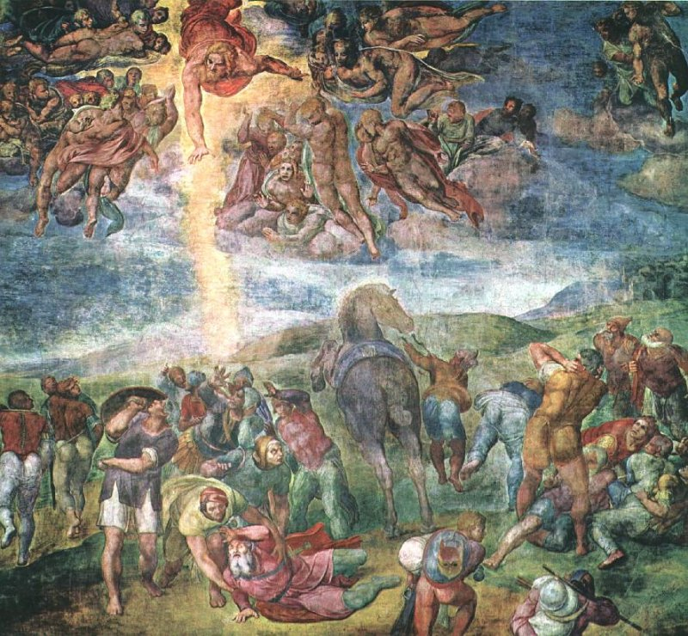
The Infallible Rule of Biblical Interpretation:
Scripture Interpreting Scripture
Michelangelo Buonarroti 1475 – 1564 The Conversion of Saul

Slide 35
The Vital Role of Scripture
in Interpreting Scripture
The only infallible rule of interpretation of Scripture is the Scripture itself: and therefore, when there is a question about the true and full sense of any Scripture (which is not manifold, but one), it must be searched and known by other places that speak more clearly.
WCF 1:9
The Issue of Redemptive-Historical vs. “Proof-texting” in Interpretation:
      WCF1.1 “therefore it pleased God at sundry times and in divers manners to reveal himself and to declare…”

Slide 36
The Role of Scripture in Interpreting Scripture
A Covenantal Way of Reading the Scripture vs. proof-texting—
There are many “texts” but one context—The redemptive history of God
NT rekation to OT—not a new religion, but a progressive revelation of redemption wherein the Old is developmentally mature in the New….
    c.f. Emmaus Road: Luke 24: 27 Then beginning with Moses and all the prophets, he interpreted to them the things about himself in all the scriptures.
    c.f. Heb. 1:1-3 Heb. 1:1Long ago God spoke to our ancestors in many and various ways by the prophets, 2 but in these last days he has spoken to us by a Son,
We must learn to read the Bible backwards and forwards looking to locate each text into the trajectory or context of the whole of redemptive history and the working out of God’s covenant with Adam ultimately…
    1. Step One: To relate the text to its immediate covenantal context
    2. Step Two: To understand the text in light of God's total revelation especially as ultimately revealed in the New Covenant

Slide 37
Advantages of Covenantal (Redemptive-Historical) Method: The Preservation of Objectifying Grace!
  1. Guards against moralizing certain passages through the use of false analogies between the biblical narrative and contemporary life even to the detriment of the fuller theological significance.
  2. Guards against a theology of "proof-texting."
  3. Can recognize both the significance of certain passages within its own redemptive context and in the present redemptive context whereby the biblical-theological understanding of scripture is made relevant to us.
  4. Guards against emotionalism and subjectivistic interpretations whereby the normative (governing) value of Biblical revelation is retained to the interpreter in any practical sense. (We are still the listeners.)
  5. Provides a proper hermeneutic from which to derived "biblical ethics."

Slide 38
A redemptive historical orientation is not some kind of dispensable exegetical luxury. At stake is nothing less than the right way of interpreting Scripture. At issue here is simply the fundamental principle that the test is to be interpreted in the light of its context. In the case of Scripture, the redemptive-historical structure or framework established by Scripture itself is the contextual factor having the broadest bearing on a given text. (
Richard Gaffin, p.xxii)
Continued Next Lesson

